Slide 1


DSA 210
Project
Subject: Travel Time Prediction and Traffic Analysis Using Machine Learning
-Göksu Arslan 31207-

Slide 2
Motivation
The main motivation of this project is to analyze how different traffic-related factors influence travel duration and to evaluate the accuracy of estimated travel times using real-life driving data. In addition, the project aims to predict travel duration using basic machine learning models and data science techniques.

Slide 3
Data Collection
Data Collection
Data collected between April 1 – April 14
Trips made by:
Author
Family members
Friends
Dataset size:
127 observations
Recorded Variables
Departure & arrival times
Actual travel duration
Estimated travel duration
Distance
Traffic level
Number of traffic lights
Rush hour information

Slide 4
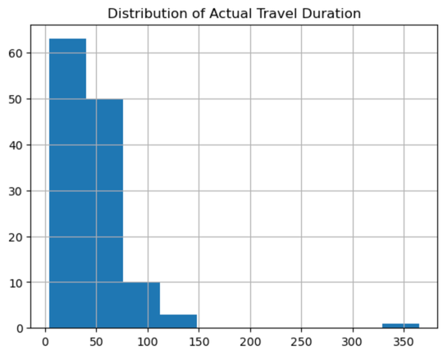
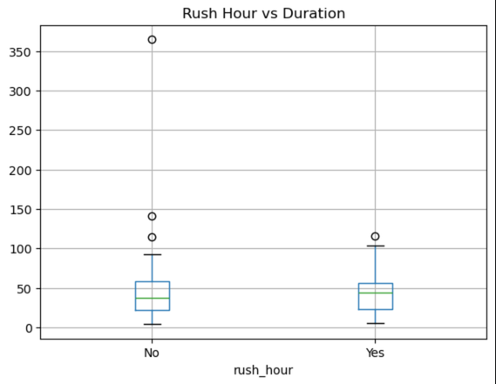
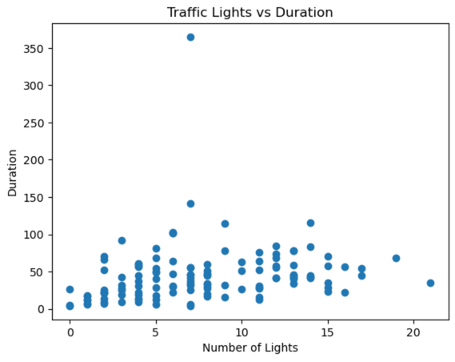
Exploratory Data Analysis
Data Preprocessing
Converted time variables into datetime format
Standardized travel durations into minutes
Created additional variables:
Delay
Rush hour indicator
Removed inconsistencies
Final dataset contained no missing values
Exploratory Data Analysis
Applied Analysis Techniques
Histogram analysis
Scatter plots
Boxplots
Correlation analysis
Traffic-level comparisons
Main Objective
Understand data distributions
Identify relationships between variables
Detect travel patterns

Slide 5
Hypothesis Testing
Independent T-Test. Rush hour vs non-rush hour effects
ANOVA Test: Traffic level differences
Paired T-Test: Estimated vs actual travel durations
Pearson Correlation Test: Correlation between distance and travel duration
One-Sample T-Test: Delay behavior
I did 5 different hypothesis tests for a better understanding of traffic components.

Slide 6
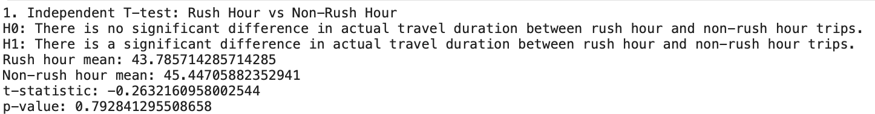
Independent T-Test.
Rush hour vs non-rush hour effects
The p-value was greater than 0.05, leading to a failure to reject the null hypothesis.
This indicates that rush hour does not have a statistically significant effect on travel duration in this dataset.

Slide 7
ANOVA Test:
Traffic level differences
The p-value was less than 0.05, leading to rejection of the null hypothesis.
This shows that traffic level has a statistically significant impact on travel duration.

Slide 8
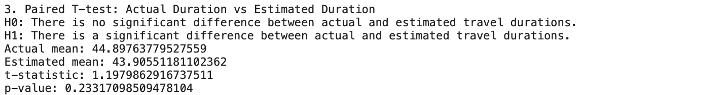
Paired T-Test:
Estimated vs actual travel durations
The test resulted in a p-value greater than 0.05, indicating no statistically significant difference between estimated and actual travel times.
This suggests that Google Maps estimates are generally accurate.

Slide 9
Pearson Correlation Tests:
Correlation between distance and travel duration
Distance showed a statistically significant strong relationship with travel duration (p < 0.05), while the number of traffic lights also showed a statistically significant but weaker relationship.

Slide 10
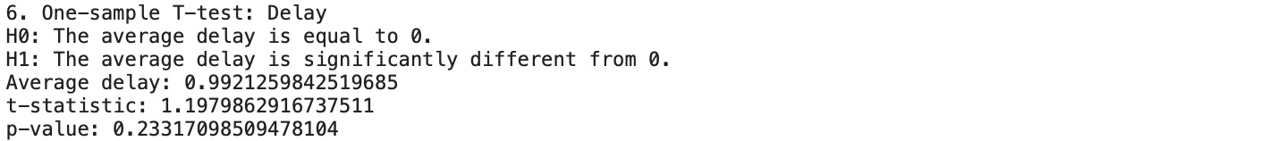
One-Sample T-Test:
Delay behavior
The average delay was not significantly different from zero, further supporting the reliability of estimated travel times.

Slide 11
Machine Learning Integration
Implemented Models
Linear Regression
Random Forest
K-Nearest Neighbors (KNN)
Decision Tree
Model Evaluation Metrics
MAE
RMSE
R² Score
Features Used
Distance
Traffic level
Estimated duration
Number of traffic lights
Rush hour information

Slide 12
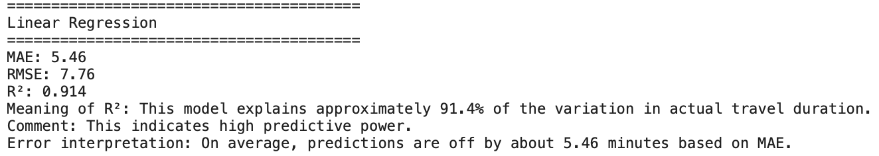
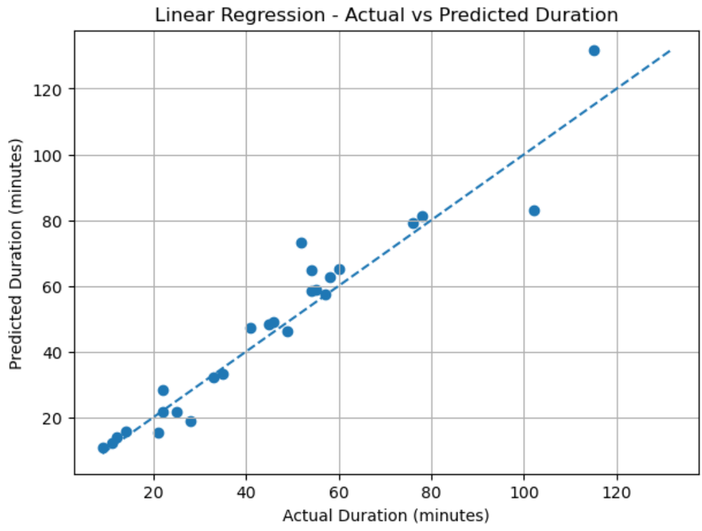
Linear Regression

Slide 13
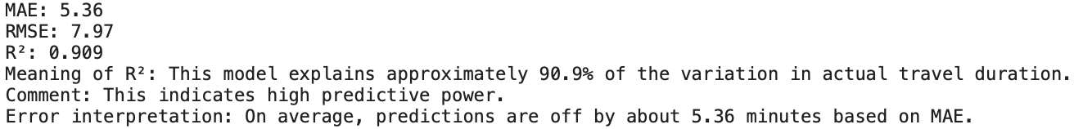
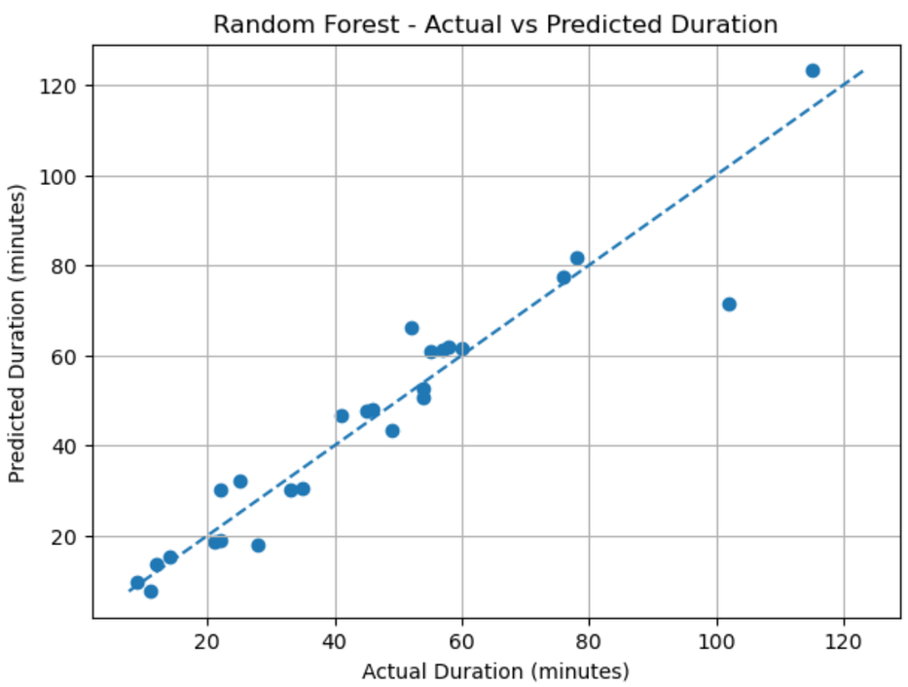
Random Forest

Slide 14
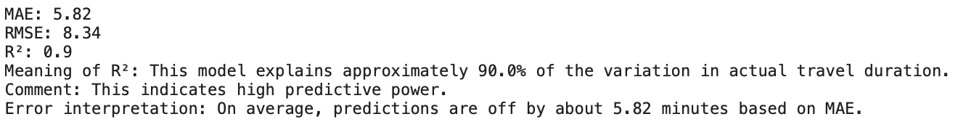
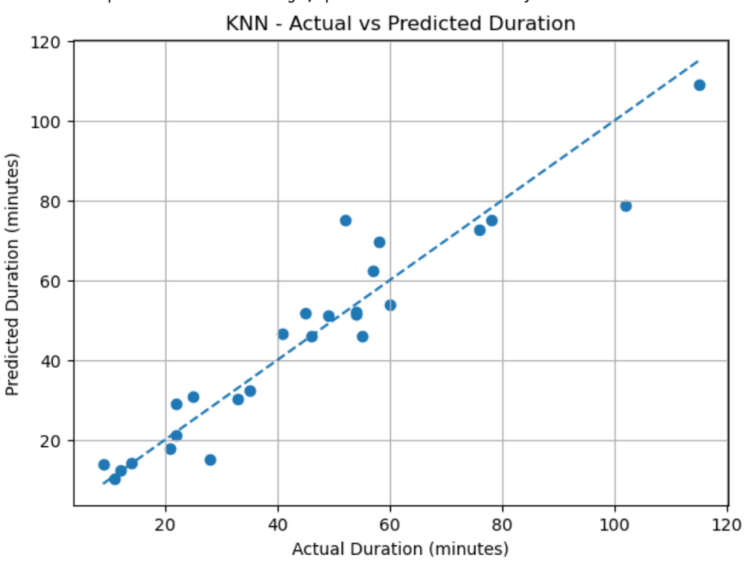
K-Nearest Neighbours

Slide 15

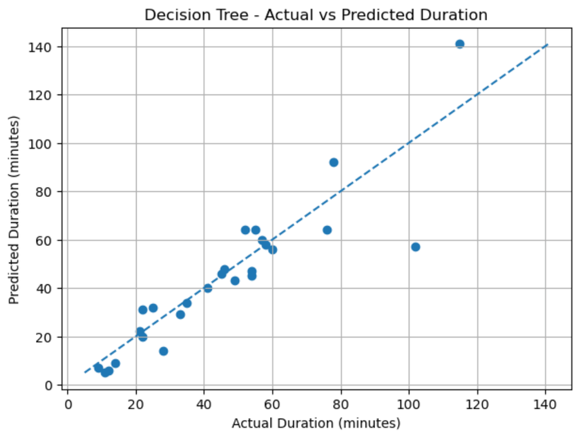
Decision Tree

Slide 16
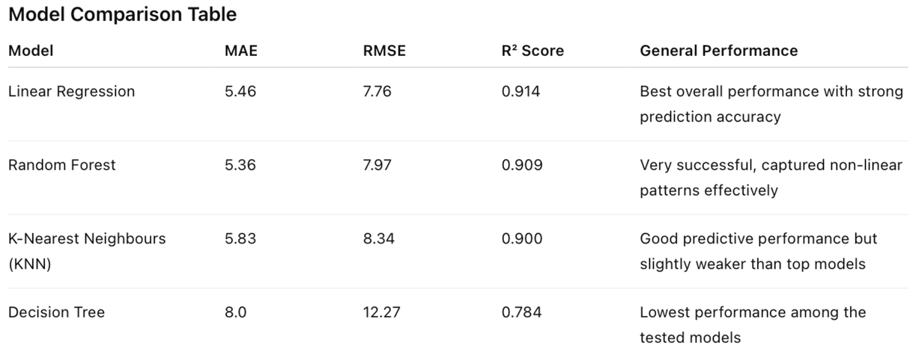
Findings
Distance showed a strong positive relationship with travel duration
Google Maps estimations were highly reliable
Traffic level significantly affected travel duration
Rush hour alone was not statistically significant
Medium and high traffic conditions increased travel duration noticeably
Number of traffic lights showed only a weak relationship with travel duration
Travel duration can be predicted successfully using simple transportation-related variables
Linear Regression achieved the best overall performance:
R² Score: 0.914
MAE: 5.46 minutes
RMSE: 7.76 minutes

Slide 17
Limitations & Future Work
Limitations
Relatively small dataset
Limited data collection period
Self-collected data may introduce bias
Limited number of variables
Future Work
Expand dataset over longer periods
Include weather and real-time traffic data
Apply more advanced ML models
Develop a real-time prediction dashboard

Slide 18
Thank
You

